Slide 1
Lecture 14
Topics:
Divisibility
Modular Arithmetic
Congruence Relation

Slide 2
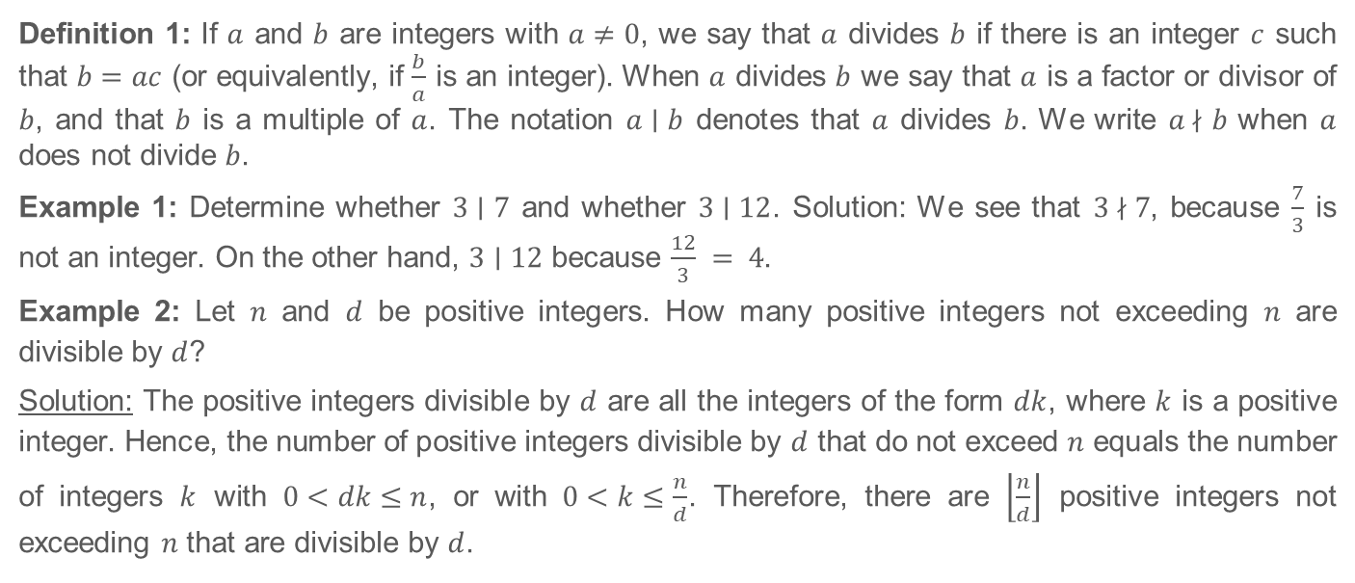
4.1 Divisibility and Modular Arithmetic

Slide 3
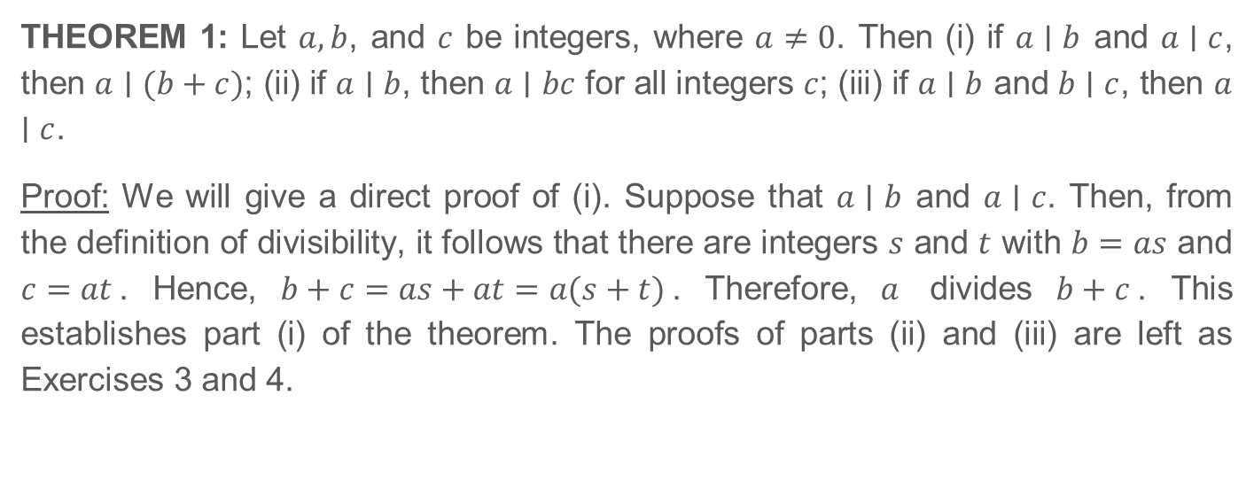
4.1 Divisibility and Modular Arithmetic (Continued)

Slide 4
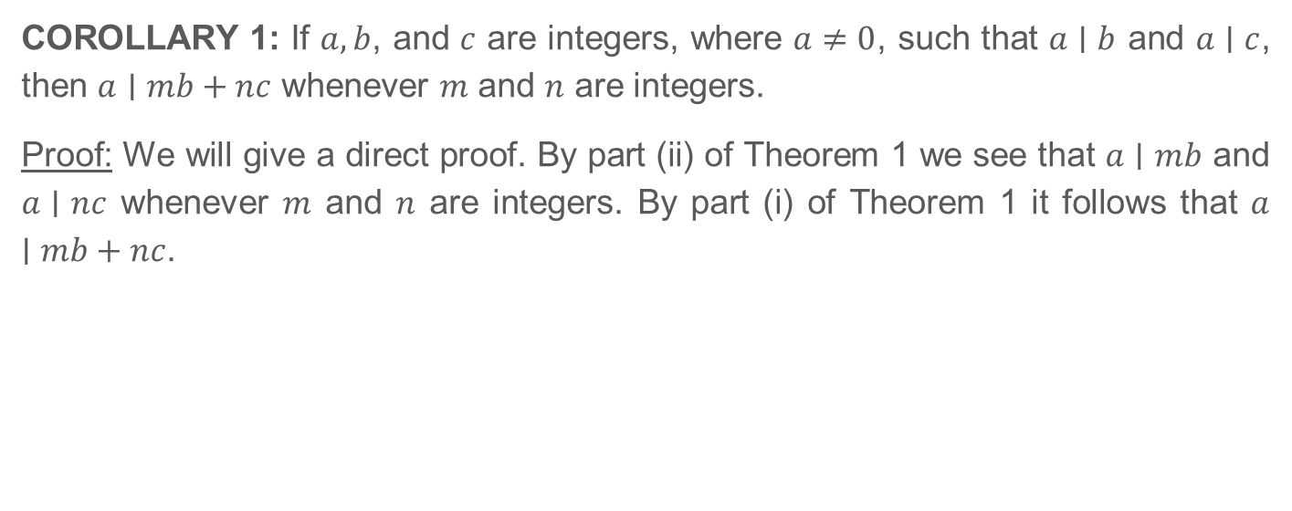
4.1 Divisibility and Modular Arithmetic (Continued)

Slide 5
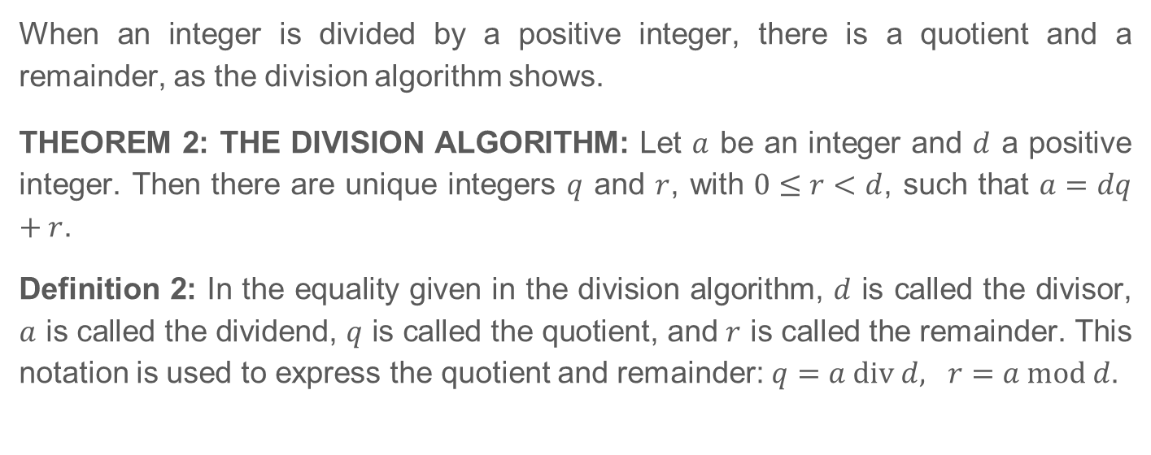
4.1.3 The Division Algorithm

Slide 6
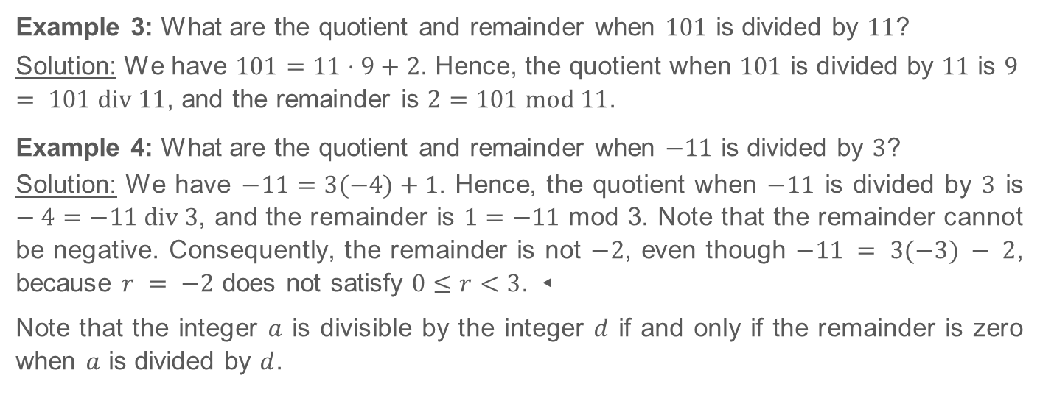
4.1.3 The Division Algorithm (Continued)

Slide 7
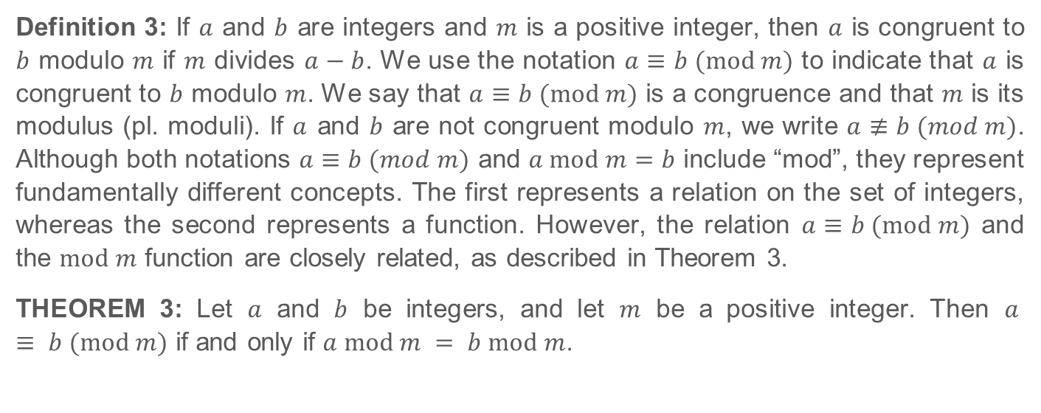
4.1.4 Modular Arithmetic

Slide 8
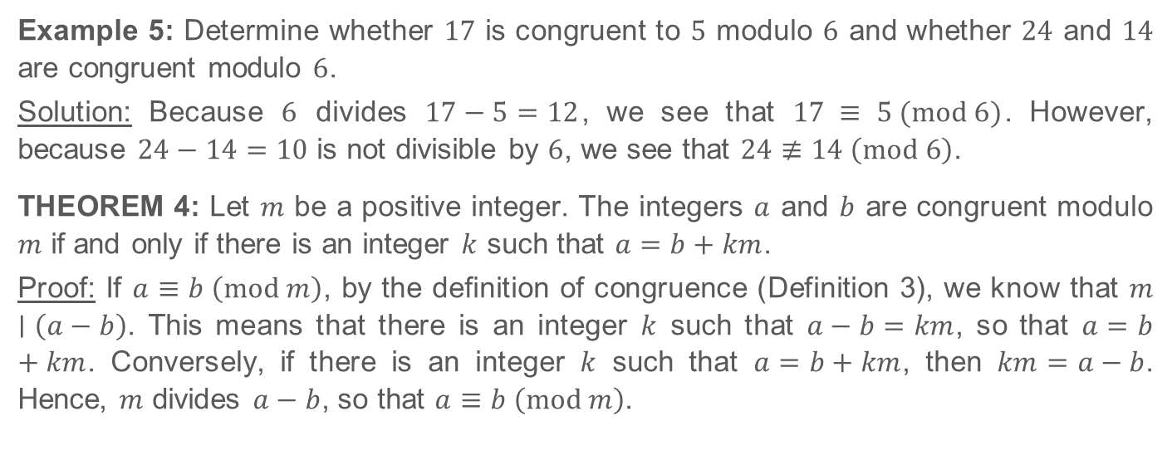
4.1.4 Modular Arithmetic (Continued)

Slide 9
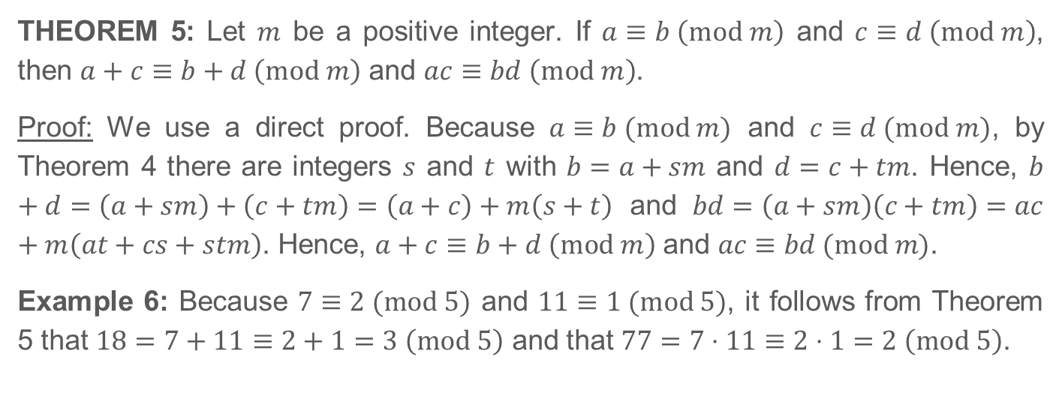
4.1.4 Modular Arithmetic (Continued)

Slide 10
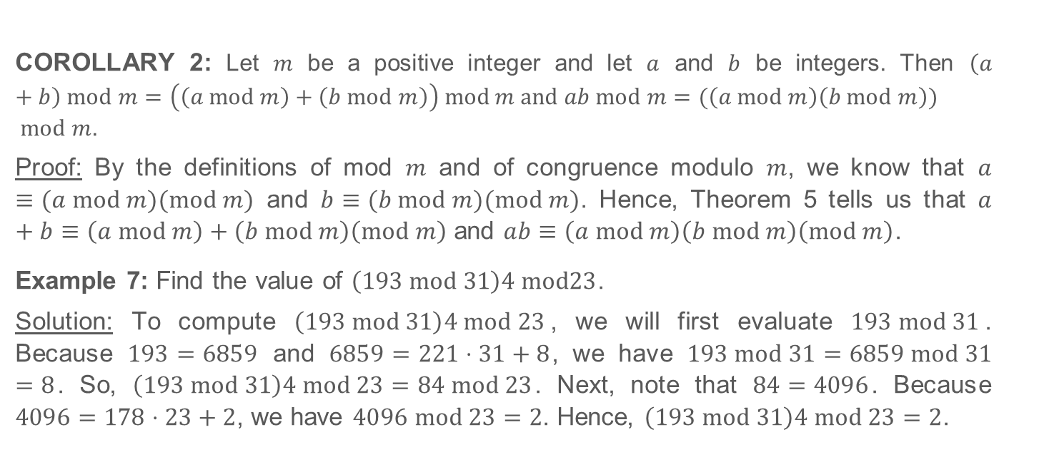
4.1.4 Modular Arithmetic (Continued)
Notes:
a = k.m+r
=> a-r = k.m
Therefore, m|(a-r)
According to the definition of congruence, a is congruent to r mod m [a ≡ r (mod m)]
We know that, r = a mod m
Therefore,
a ≡ r (mod m)
or, a ≡ (a mod m)(mod m)

Slide 11
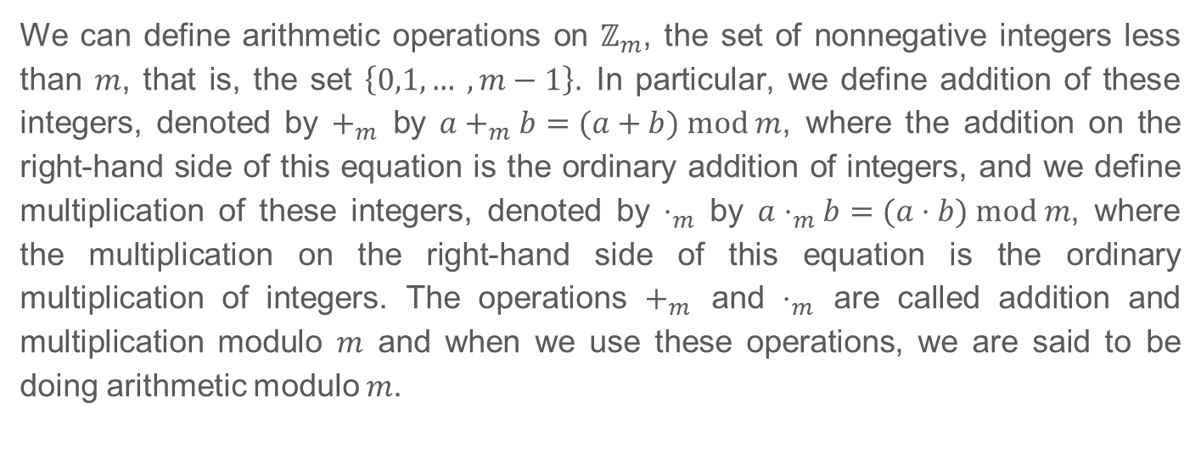
4.1.5 Arithmetic Modulo m

Slide 12
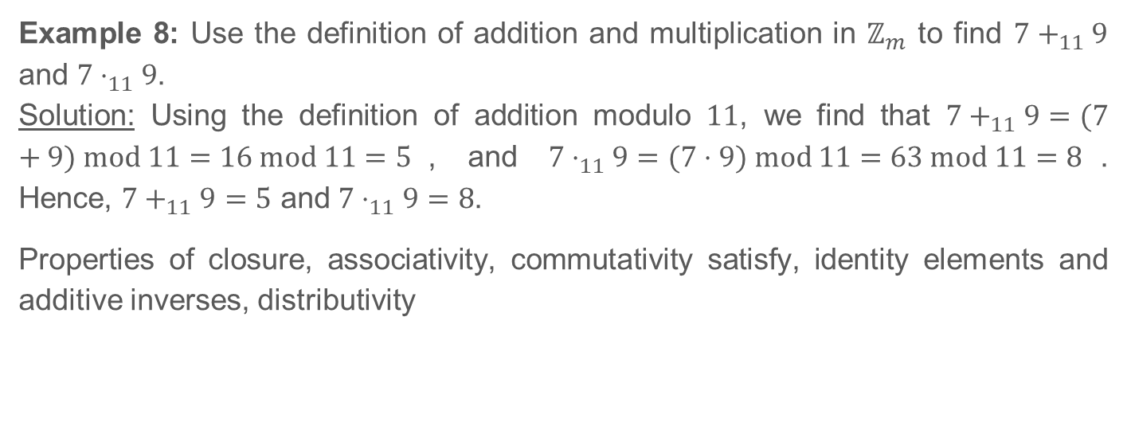
4.1.5 Arithmetic Modulo m (Continued)

